Slide 1


MALAKAND CAMPUS CHAKDARA KPK PAKISTAN

Slide 2
RIPHAH INTERNATIONAL UNIVERSITY
MALAKAND CAMPUS CHAKDARA KPK PAKISTAN

Slide 3
Lecture 5 & 6
Semiconductor (n-Type, p-Type, PN junction)
MALAKAND CAMPUS CHAKDARA KPK PAKISTAN

Slide 4
Extrinsic Semiconductor:
A semiconductor to which an impurity at controlled rate is added to make it conductive is known as an extrinsic Semiconductor.
Or we can say that
A semiconductor material that has been subjected to the doping process is called an extrinsic material.

Slide 5
The characteristics of pure semiconductor material can be altered significantly by the addition of specific impurity items .
The addition of these impurities can alter the band structure sufficiently to totally change the electrical properties of the material.
As a result of this doping there are two types of extrinsic semiconductors.
n-Type Material
p-Type Material

Slide 6
Doping:
The process by which an impurity is added to a semiconductor is known as Doping. The amount and type of impurity which is to be added to a material has to be closely controlled during the preparation of extrinsic semiconductor.
Generally, one impurity atom is added to a 10¹⁰ atoms of a semiconductor.
The purpose of adding impurity in the semiconductor crystal is to increase the number of free electrons or holes to make it conductive.

Slide 7
n-type Semiconductor
An n-type material is formed by adding a predetermined number of impurity atoms to a silicon base.
To increase the number of conduction band electrons in intrinsic silicon, Pentavalent impurity atoms are added such as Arsenic (As),
Phosphorus (P), Bismuth (Bi), and Antimony (Sb).
The effect of such impurity elements

Slide 8
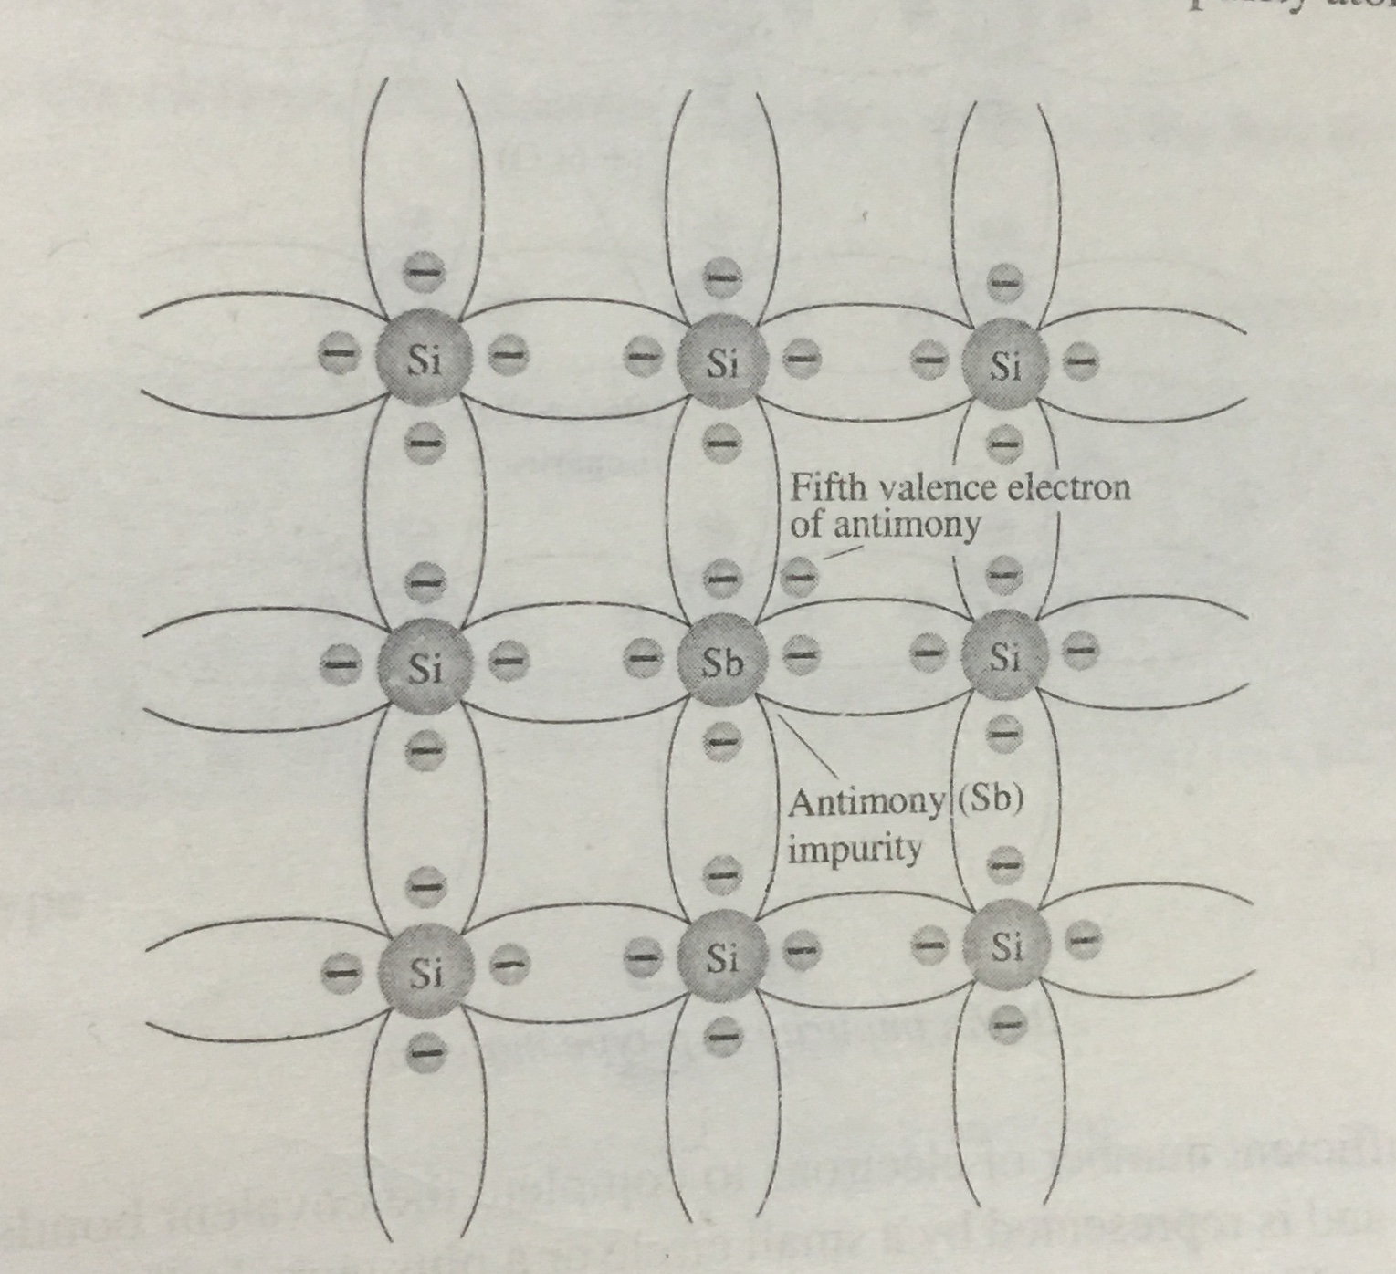
The effect of such impurity elements in indicated in
the following figure,
Note that the four covalent bonds are still present.
There is however, an additional fifth electron due
to impurity atom, which is unassociated with any
particular covalent bond. This remaining electron,
Loosely bound to its parent(antimony) atom, is
relatively free to move within the newly formed
n-type material.
Antimony(Sb) impurity in n-type material

Slide 9
Diffused impurities with five valance electrons are called donor atoms.
Although it is important to realize that even though a large number of free carriers have been established in the n-type material, it is still electrically neutral since ideally the number of positively charged protons in the nuclei is still equal to the number of free and orbiting negatively charged electrons in the structure.
A conduction electron created by this doping process does not leave a hole in the valance band because it is in access of the number required to fill the valance band.

Slide 10
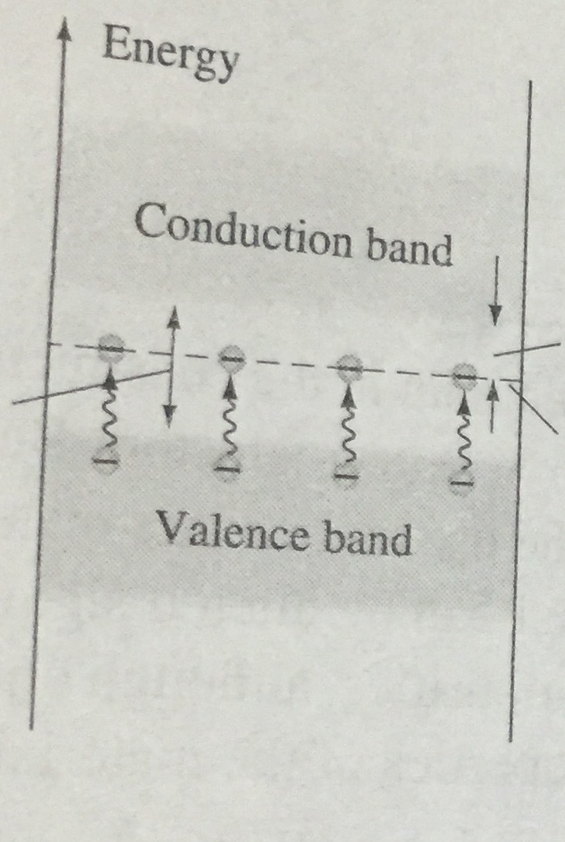
The effect of this doping process on the relative
conductivity can best be described the sue of
energy-band diagram.
Note that Eg( donor level) < Eg (intrinsic material).
From the figure, those free electrons due to the
added impurity sit at this energy level and have
less difficulty absorbing a sufficient measure
of the thermal energy to move into the conduction band
at room temperature.
Donor energy level
Eg for intrinsic material
Effect of the donor impurities on the energy band structure

Slide 11
The result is that at room temperature there are a lot number of free carrier (electrons) in the conduction level, and the conductivity of the material increases significantly.
At room temperature in an intrinsic “Si” material there is about one free electron for every 10¹² atoms. If the dosage level is one in 10⁷ then the ratio 10¹² /10⁷ =10⁵ indicates that the carrier concentration has increased by a ratio of 100,000 : 1.

Slide 12
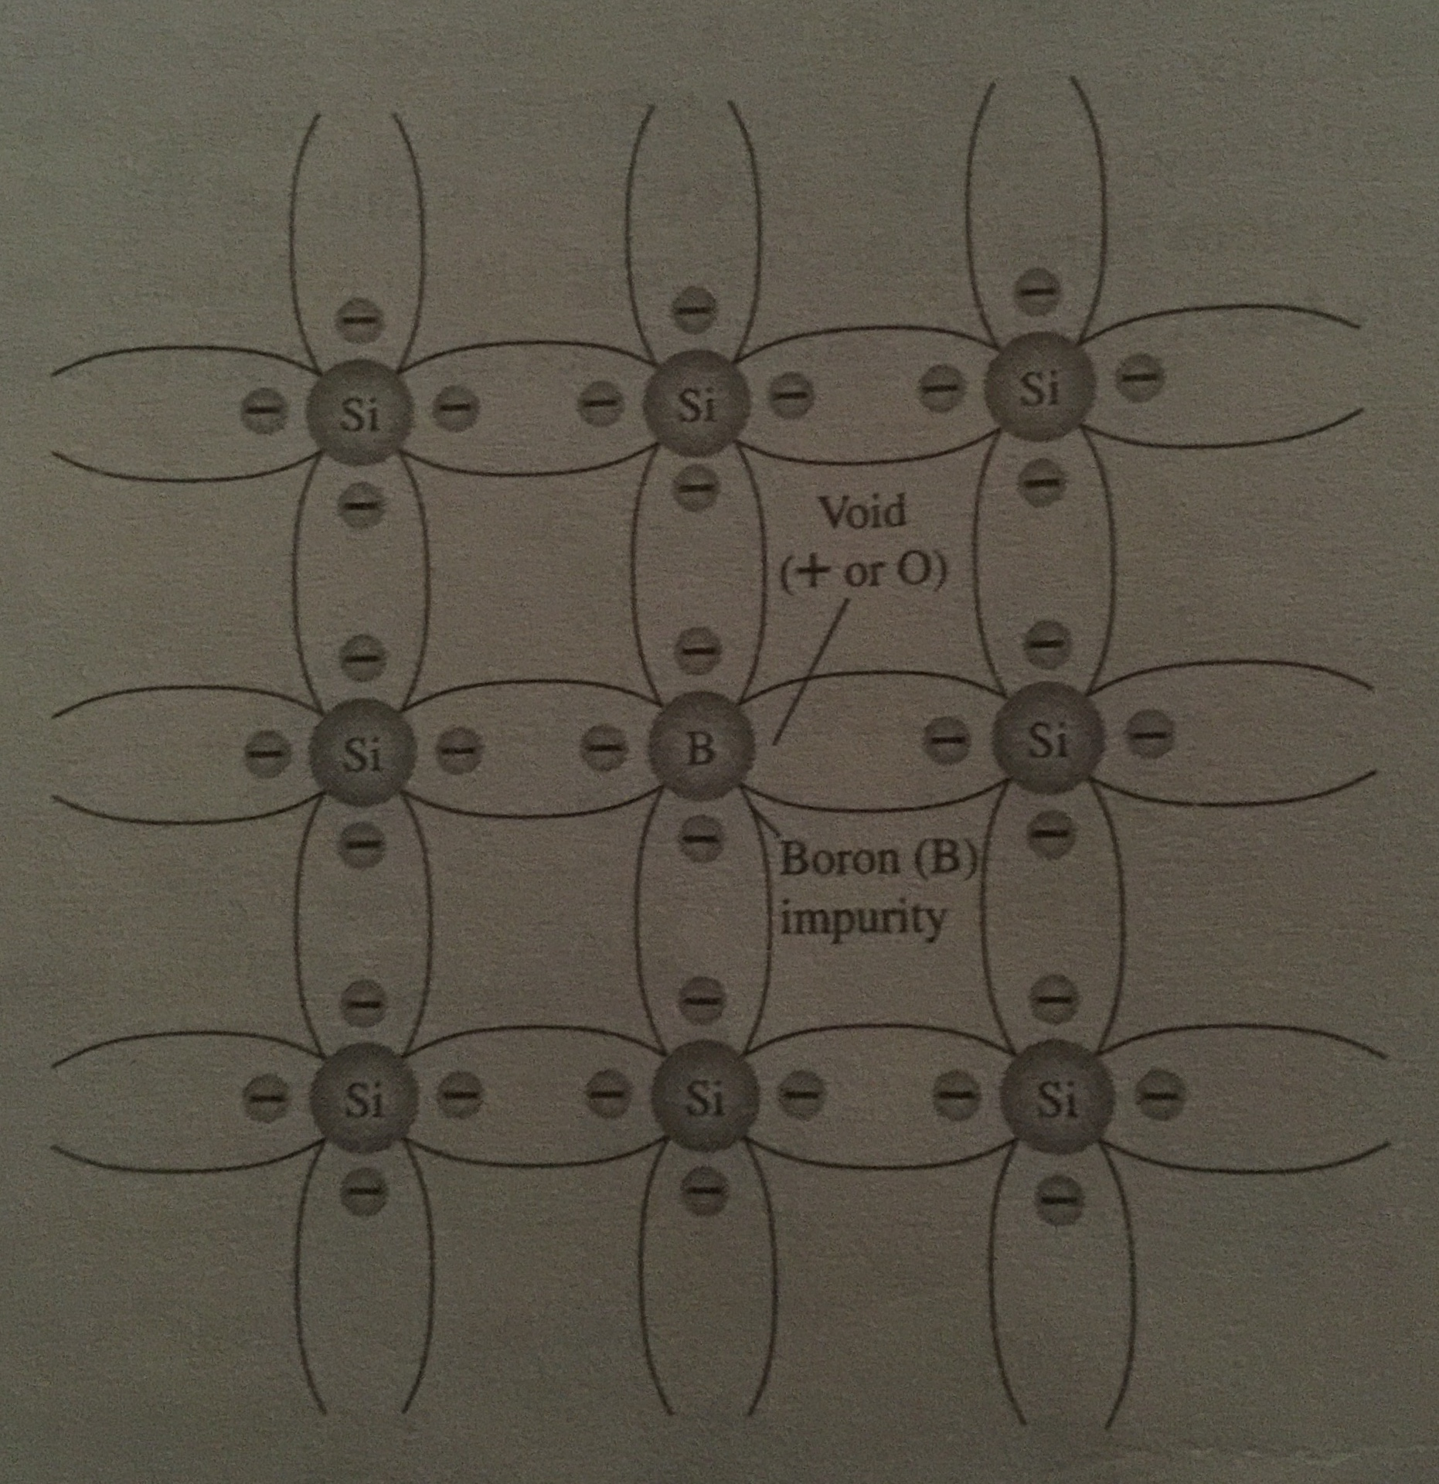
2) p-type Semiconductor:
The p-type material is formed by doping a pure germanium or silicon crystal with impurity atoms having three valance electrons. The elements most frequently used for this purpose is boron, indium and gallium.
Boron impurity in p-type material

Slide 13
Note there is now insufficient numbers of electrons to complete the covalent bonds of the newly formed lattice.
The resulting vacancy is called a hole and is represented by a small circle or a plus (+) sign, indicating the absence of negative charge.
Since the resulting vacancy will readily accept the free electron.
The diffused impurities with three valance electrons are called acceptor atoms.
The resulting of p-type material is electrically neutral , for the same reasons described for n-type material.

Slide 14
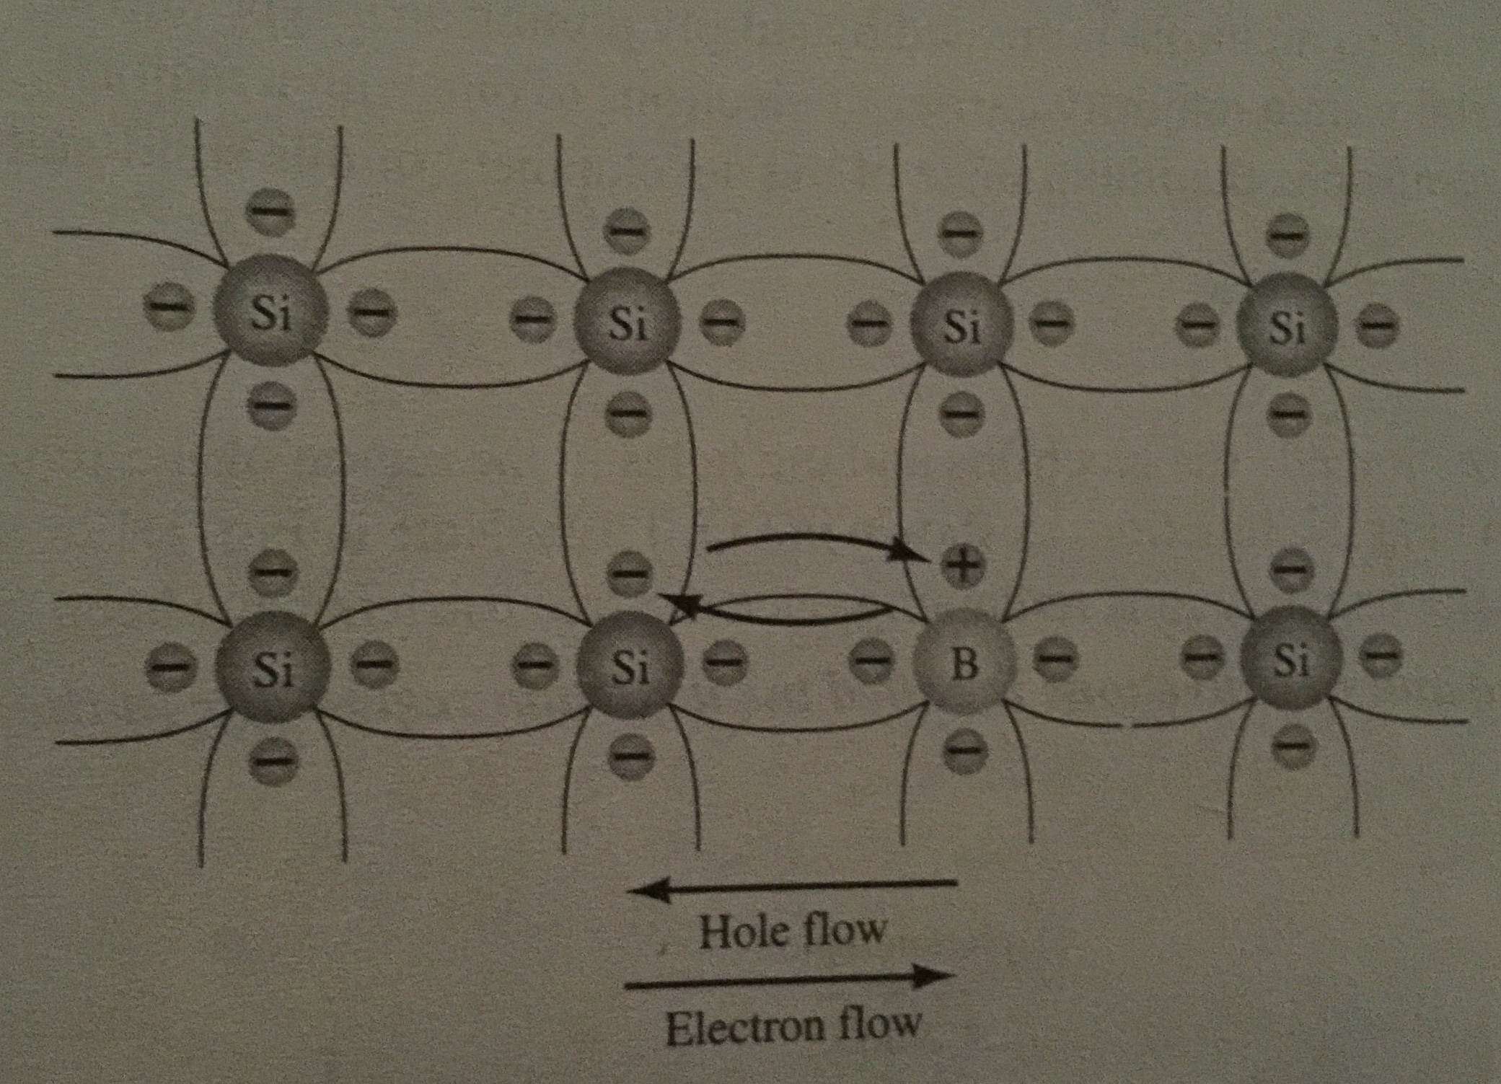
Electron versus hole flow:
If a valance electron acquires sufficient
kinetic energy to break its covalent bond
and fill the void created by a hole, then
a vacancy, or hole, will be created in the
Covalent bond that released the electron.
There is, therefore a transfer of holes to
the left and electrons to the right as
Indicated in the figure. Therefore the
direction indicated by hole flow is said to be
conventional flow.

Slide 15
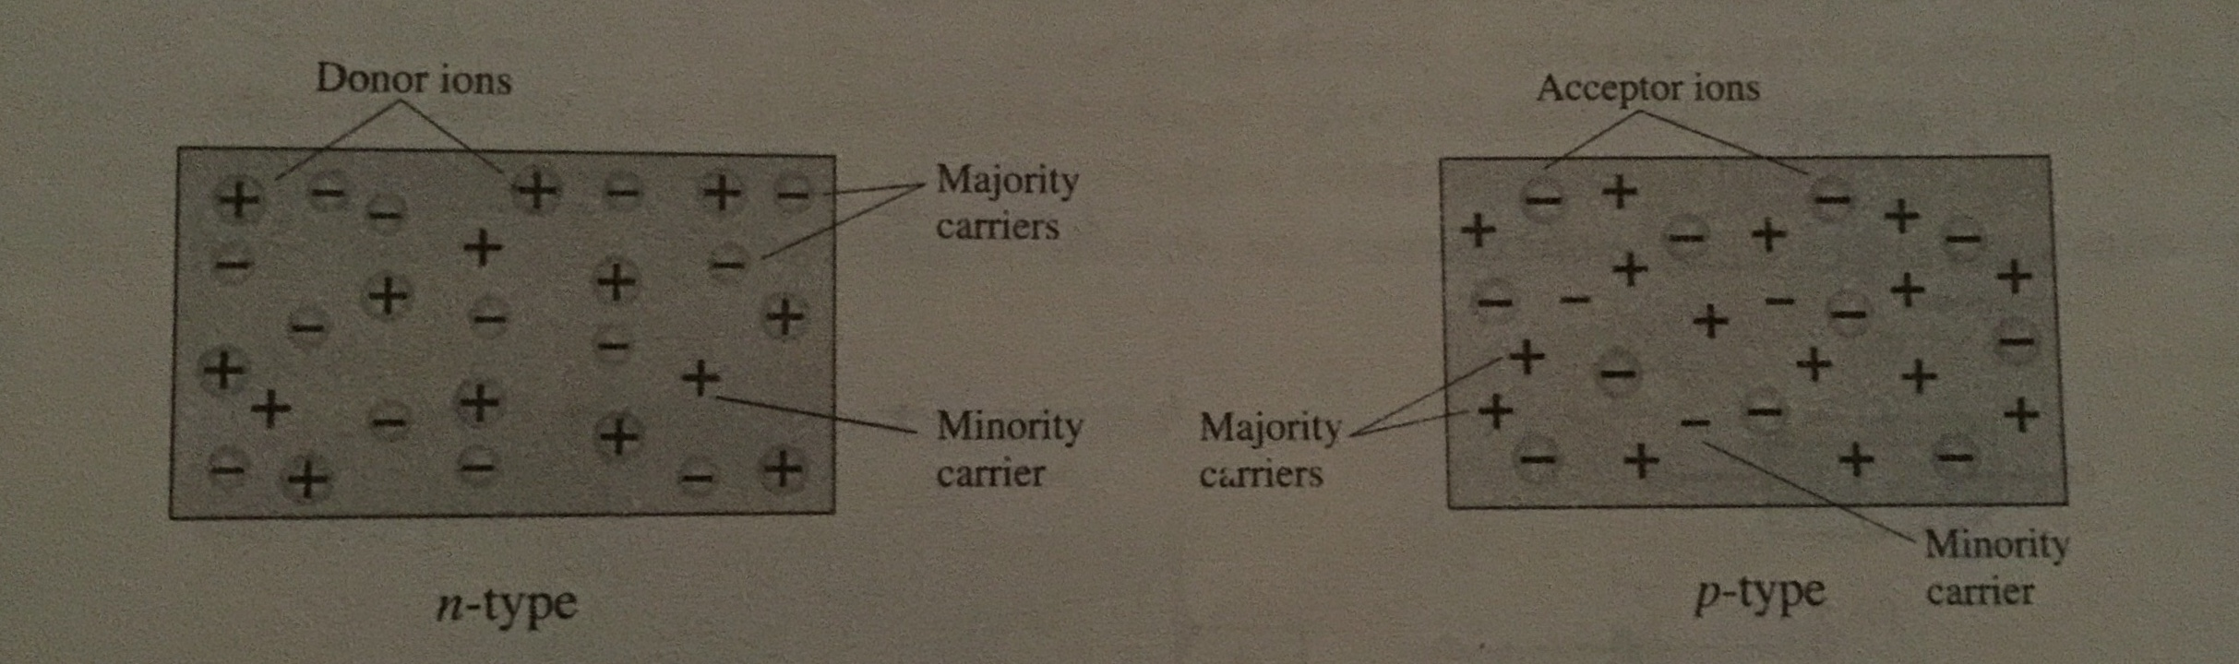
Majority and Minority carriers in n-type & p-type semiconductor:
Since most of the current carriers are electrons, silicon doped with Pentavalent atoms is an n-type semiconductor whereas the n stands for the negative charge on an electron. Thus the electron's are called the majority carriers in n-type material.

Slide 16
Although the majority of current carriers in n-type material are electrons, there are also few holes that are created when electron-hole pair are thermally generated.
These holes are not produced by the addition of the Pentavalent impurity atoms. Holes in an n-type material are called minority carriers.
For p-type material the number of holes for outweighs the number of electrons, therefore:
In p-type material the hole is the majority carrier and the electron is the minority carrier.

Slide 17
The n-type and p-type material represents the basic building blocks of semiconductor devices. The joining of n-type and p-type material will result in a semiconductor element of considerable importance in electronic system.

Slide 18
PN junction:
If a block of silicon is doped with a trivalent impurity and the other part with Pentavalent impurity, a boundary called pn junction is formed between the resulting p-type and n-type portions and the basic semiconductor element is formed which is know as diode.
Diode is a device that conducts current in one direction.
P
N
Pn junction / diode

Slide 19
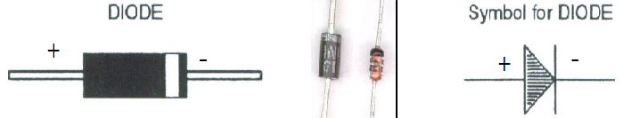
Structure & Symbol for diode:

Slide 20
PN junction:
The p region has many holes ( majority carriers) from the impurity atoms and only a few thermally generated free electrons(minority carriers).
While the n region has many free electrons (majority carrier) from the impurity atoms and only a few thermally generated holes (minority carriers).

Slide 21
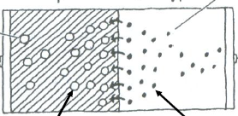
PN junction
PN junction
Holes P region
N region electrons

Slide 22
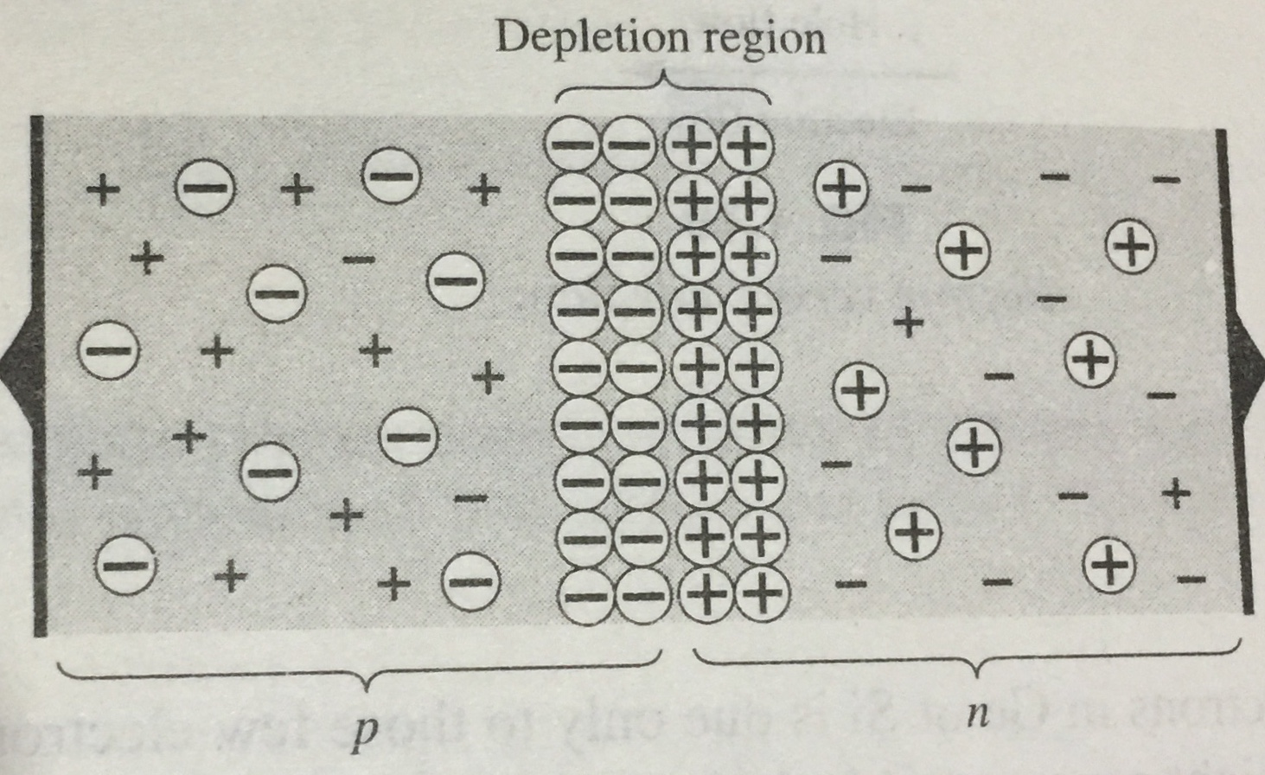
Formation of depletion region:
As the pn-junction is formed, the free electron near the junction in the n region begin to diffuse across the junction into the p region where they combine with the holes near the junction.
The n region loses electrons as they diffuses
across the junction. This creates a layer of
Positive charges near the junction. As the
electrons moves across the junction , the p region
Loses holes as the electrons and holes combined.
This creates a layer of negative charges near the junction. Thus these two layers of positive and negative charges form the depletion region.

Slide 23
Formation of depletion region:
The region depletion refers to the fact that the region near the pn junction is depleted of charges due to diffusion across the junction.
The depletion region formed is very quickly and is very thin compared to the n region and p region.
A point reaches where the total negative charges in the depletion region repels any further diffusion of electrons into the p region and thus the diffuses stops.
In other words, depletion region acts as a barrier to further movement of electrons across the junction.

Slide 24
Biasing of diode:
No electrons move through the pn junction at equilibrium. Generally the word bias refers to the use of external source (dc source) of voltage to establish certain operating condition.
For an electronic device such as Diode, there are two bias conditions: forward bias and reverse bias.

Slide 25
Forward Biasing of diode:
Forward bias is the condition where a dc voltage is applied across its two terminals allowing current through pn junction.
There are two requirements of Forward Biasing
The negative terminal is connected to the n-type whereas the positive side is connected to the p-type . This external bias voltage is designated as Vbias.
The Vbias must be greater than the barrier potential.

Slide 26
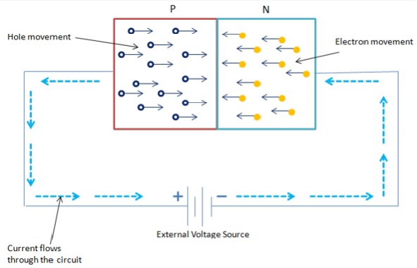
Forward Biasing of diode:
You can see that the positive terminal of the
battery is connected to the P material and the
negative terminal of the battery is connected
to the N material.
We observer the following from the figure in the forward biasing of diode.
This bias voltage Vbias repels the majority current carriers of each P and N type material. As a result, large number of holes and electrons start appearing at the junction.

Slide 27
Forward Biasing of diode:
At the N-side of the junction, electrons move
in to neutralize the positive ions in the depletion
region.
On the P-side material, electrons are dragged
from negative ions, which cause them to become
neutral again. This means that forward biasing collapses
the depletion region and hence the barrier potential too.
It means that when P-N junction is forward biased, it will allow
a continuous current flow.

Slide 28
Forward Biasing of diode:
As a result of constant supply of external voltage connected to the diode more electrons are available for flow. The flow and direction of the current is shown by large arrows outside the diode in the diagram. Note that the electron flow and the current flow refers to the same thing.

Slide 29
Forward Biasing of diode:
Lets say that electrons flow through a wire from the negative terminal of the battery to the N-material. Once these electrons enter this material, they flow immediately towards the junction.
On the other side an equal number of electrons are pulled from P-type and are returned to the positive terminal of the battery. This action creates new holes and causes them to move toward the junction.

Slide 30
Forward Biasing of diode:
When these holes and electrons reach the junction they join together and effectively disappear.
As a result, new holes and electrons emerge at the outer ends of the diode. These majority carriers are created on a continuous basis. This action continues as long as the external voltage source is applied.

Slide 31
Forward Biasing of diode:
When diode is forward biased it can be noticed that electrons flow through the entire structure of diode. This is common in N type material, whereas in the P material holes are the moving current carriers.
Notice that the hole movement in one direction must begin by electron movement in the opposite direction. Therefore, the total current flow is the addition of holes and electrons flow through a diode.

Slide 32
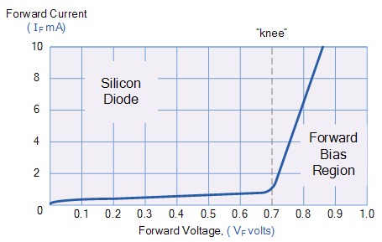
V-I Characteristics of Forward Bias:
With 0V across the silicon diode , there is no forward current.
With the slight increase of V, the forward current ID is gradually increases.
When the forward bias voltage VF is increased to a value where the voltage across the diode reaches approx. 0.7v ( barrier potential), at the knee of the curve, the forward current begins to increase rapidly as in the above figure.
B
C
A

Slide 33
V-I Characteristics of Forward Bias:
Three points A, B & C are shown on the figure.
Point A corresponds to a zero-bias condition where no current is detected.
Point B corresponds to the above figure where the forward voltage is less than the barrier potential of 0.7v .
Point C corresponds to the figure given ,where the forward voltage approximately equals the barrier potential.
C
A
B

Slide 34
Assignment # 1
How does reverse biasing of diode occurs?

Slide 35


Thank You

